Slide 1
Kestrel Dual-Mesh Simulations for DPW-VII: Expanding the Envelope
Brent Pomeroy
NASA Langley Research Center
Configuration Aerodynamics Branch
CFD Drag Prediction Workshop VII
2022 AIAA AVIATION Forum
June 25-26, 2022

Slide 2
Outline
Kestrel Overview and Compute Environment
Grids and Computational Methodology
Selected Cases
Case 1a: Grid Convergence Study
Case 2a: Alpha Sweep
Case 3: Reynolds Number Sweep
Case 4: RANS Grid Adaptation
Case 5: Beyond RANS (DDES with Grid Adaptation)
Extra credit interspersed throughout various Cases
Conclusions

Slide 3

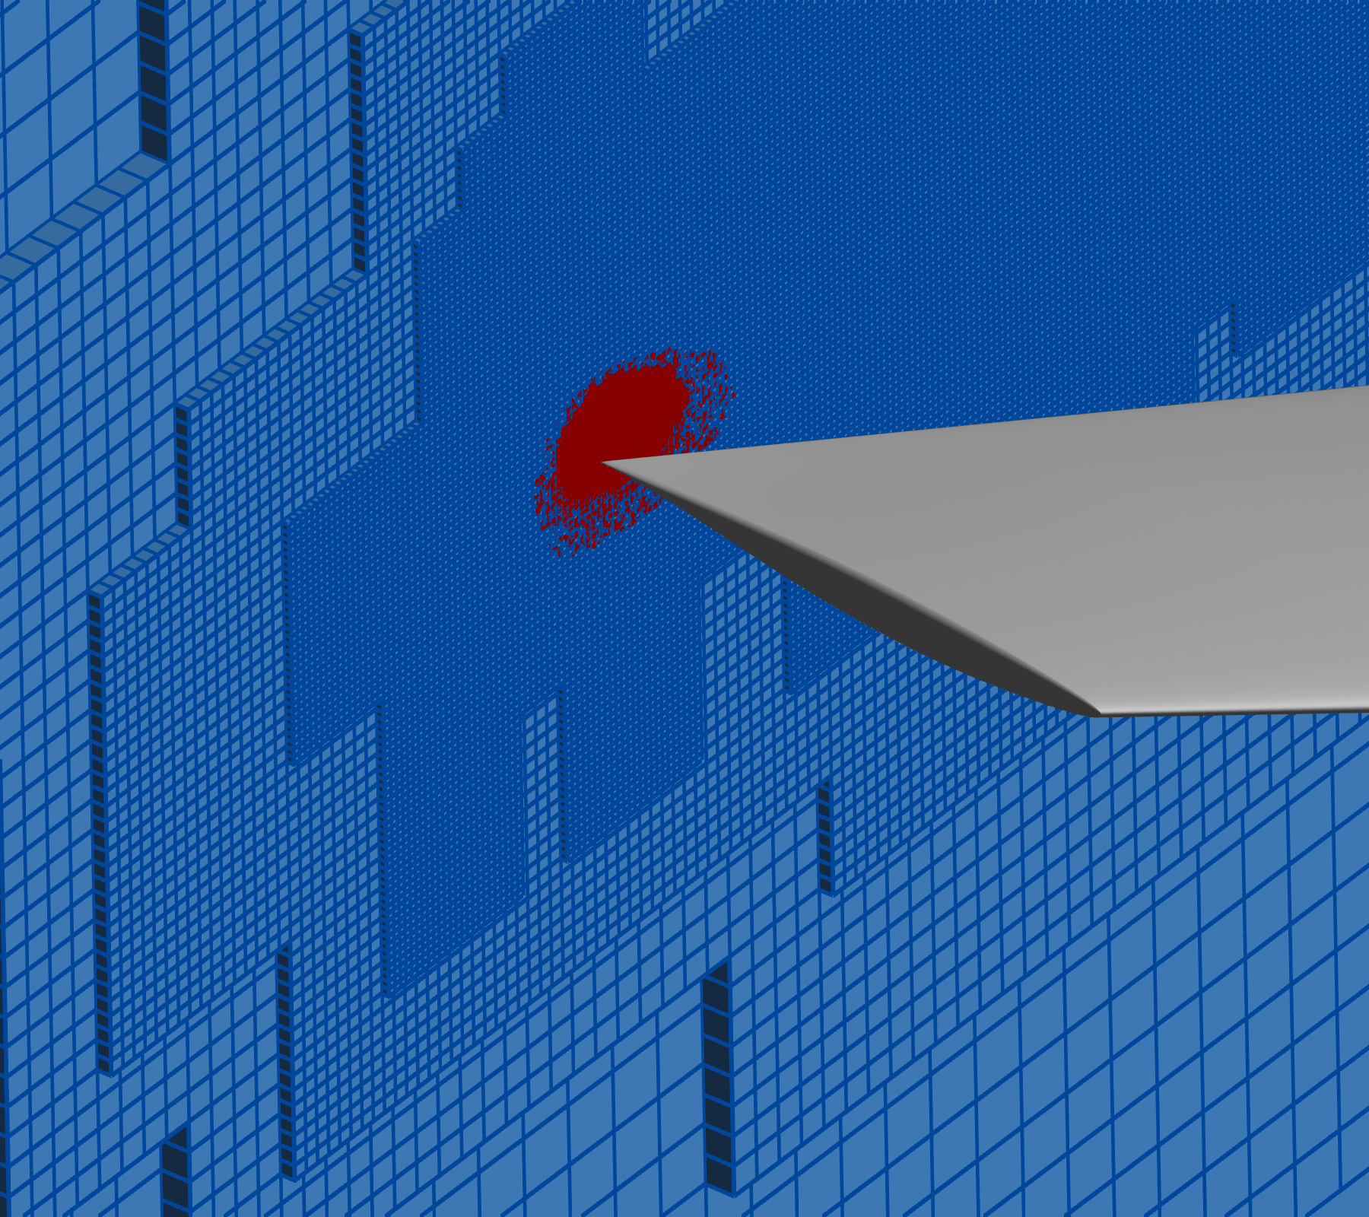
Kestrel CFD Solver
High-fidelity code from Department of Defense CREATE-AV
Multidisciplinary tool that couples aerodynamics, S&C, thermochemistry, and propulsion
Cell centered
Includes RANS, URANS, and DDES schemes
Alpha-seeking for local time stepping
Alpha and C_{L} seeking for global time stepping
Inner/outer dual-mesh approach
Static inner unstructured grid
Static or adaptive offbody Cartesian grid
Unstructured grid trimmed at constant distance
Executed with Kestrel 12.1 SDK
Outer Cartesian Grid
Inner Unstructured Grid

Slide 4
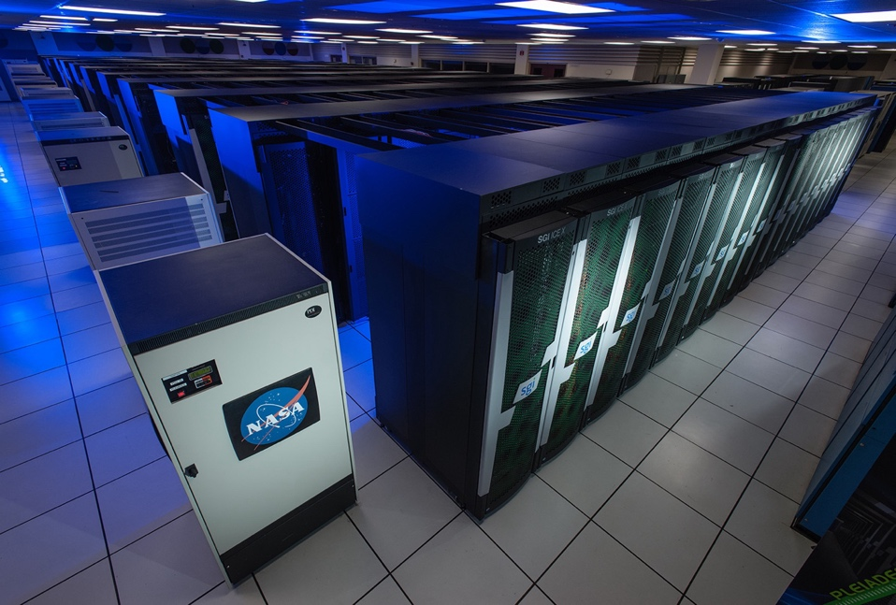
Supercomputing Environment
Executed on NASA Advanced Supercomputing (NAS) facility
Comprised of four different supercomputers (Pleiades, Electra, Aitken, and Endeavour)
More than 11,000 nodes and 241,000 compute cores
Contains both Intel and AMD chips; TOSS3 (Linux 3) operating system
Resource usage for DPW-VII
Intel Skylake nodes on Electra (a few select jobs on Haswell)
Between 1,600 and 3,200 processors
Walltime from a few hours to days
Total of 216 simulations
Well in excess of 30 requested jobs for Cases 1a, 2a, 3, 4, and 5
Large number of runs due to significant additional investigation and alpha-searching

Slide 5
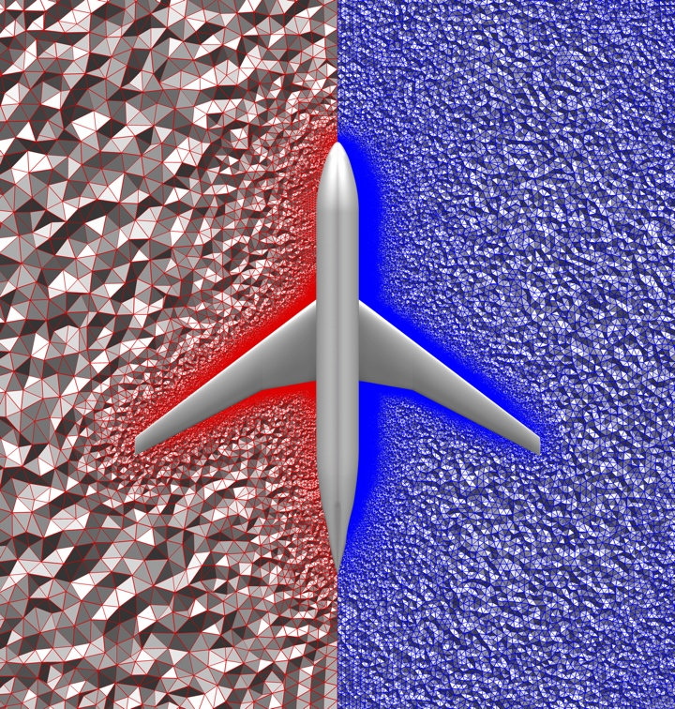
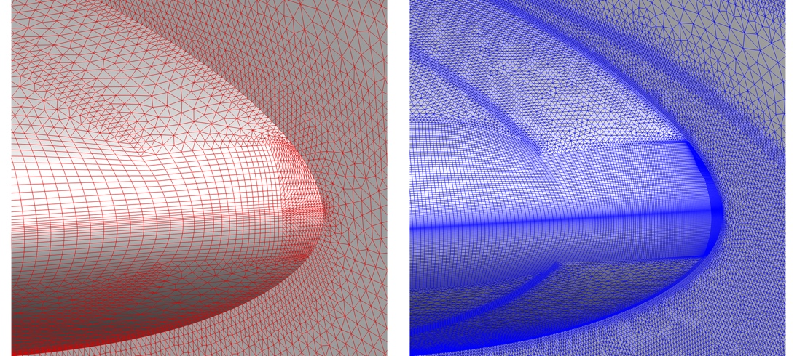
Grid Overview (1/2)
Committee-supplied JAXA unstructured grids
Variety of aeroelastic deformations
Six different grid densities
Tiny
Ultra Fine
 | Tiny | Coarse | Medium | Fine | Extra Fine | Ultra Fine
Level | L1 | L2 | L3 | L4 | L5 | L6
Approximate Cell Count | 8.7 x 10⁶ | 26.9 x 10⁶ | 60.2 x 10⁶ | 111.8 x 10⁶ | 184.1 x 10⁶ | 291.2 x 10⁶

Slide 6
Grid Overview (1/2)
Committee-supplied JAXA unstructured grids
Variety of aeroelastic deformations
Six different grid densities
Tiny
Ultra Fine
 | Tiny | Coarse | Medium | Fine | Extra Fine | Ultra Fine
Level | L1 | L2 | L3 | L4 | L5 | L6
Approximate Cell Count | 8.7 x 10⁶ | 26.9 x 10⁶ | 60.2 x 10⁶ | 111.8 x 10⁶ | 184.1 x 10⁶ | 291.2 x 10⁶
 | Fully Unstructured | Adaptive Unstructured | Fixed Cartesian | Adaptive Cartesian
Case 1a | ✓ |  | ✓
Case 2a |  |  | ✓
Case 3 |  |  | ✓
Case 4 |  |  |  | ✓
Case 5 |  |  |  | ✓

Slide 7
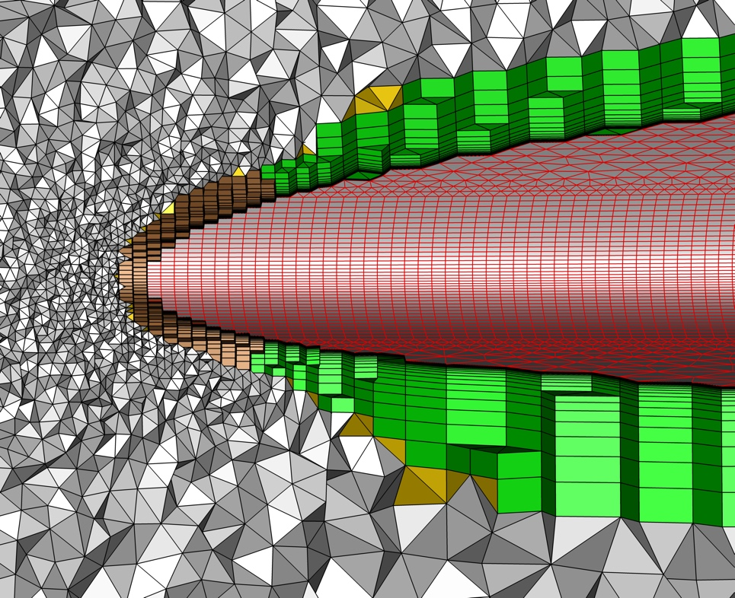
Grid Overview (2/2)
Mixed element surface and volume grid
Surface grid made of quadrilaterals and triangles
Volume grid included tetrahedron, pyramids, prisms, and hexahedron
Surface
Red: quadrilaterals and triangles
Volume
Gray: tetrahedron
Gold: pyramids
Green: prisms
Brown: hexahedron

Slide 8
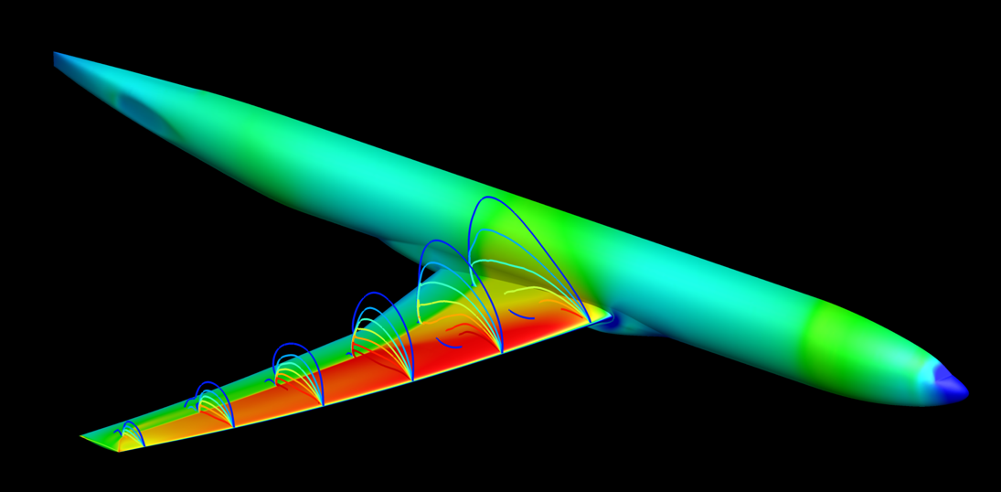
Solution Setup
Computational approach
HLLE++ inviscid flux and LDD+ viscous flux
Second-order spatial and temporal accuracy
Temporal damping applied to inner and outer grid
Fully-turbulent SARC-QCR (QCR2000)
KCFD (inner solver) and SAMAir (outer solver)
Executed all RANS cases to 20,000 iterations, regardless of convergence behavior
Appreciation extended to the Committee for accelerating development of the reduction scripts and data file format

Slide 9
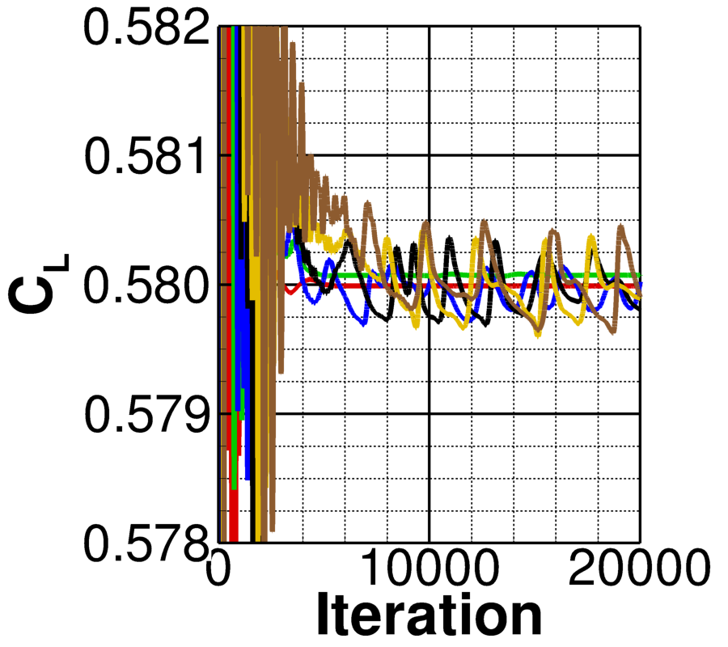
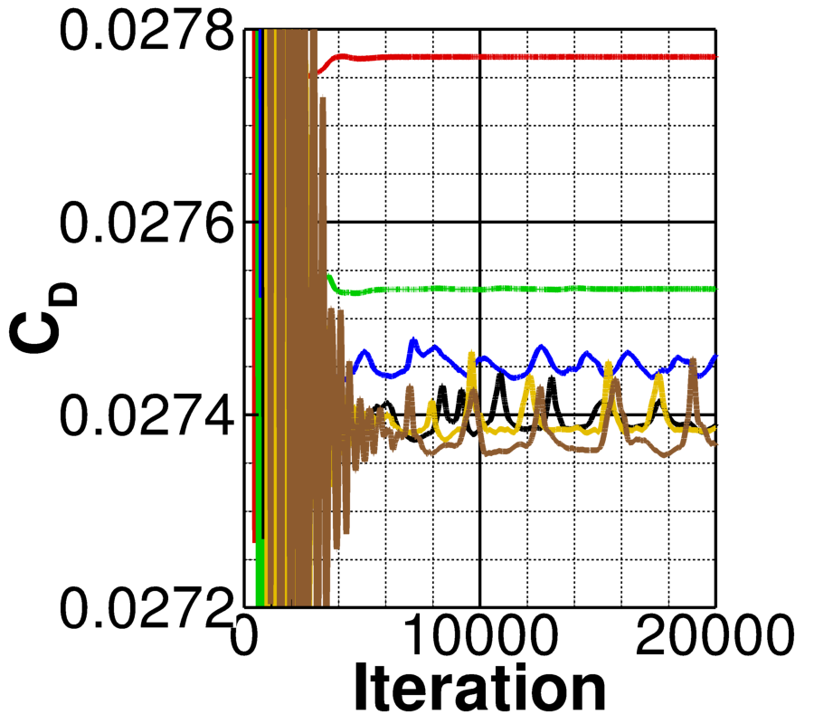
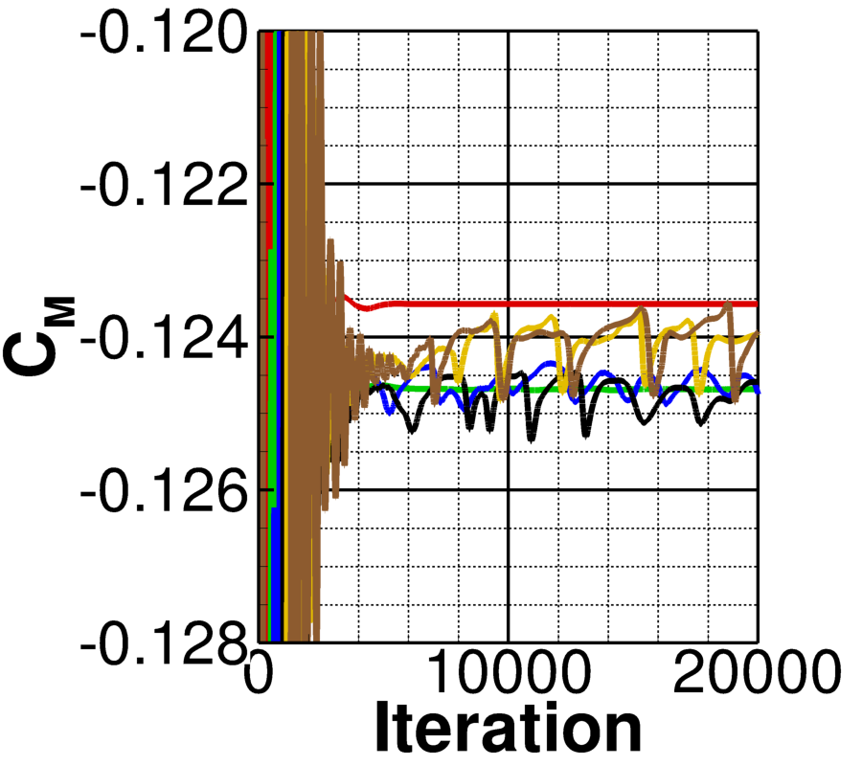
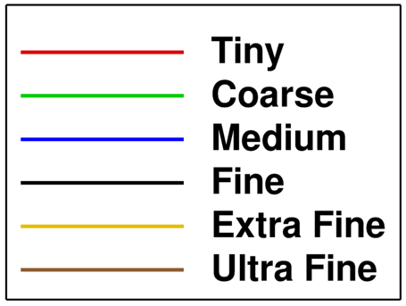
Case 1a: Unstructured Grid Convergence
Mach 0.85
Re = 20 million
C_{L} = 0.58
Simulations executed on all six densities
Data averaged over last 2,000 iterations
From user’s best practices; may need more analysis
More stable grid convergence for coarser grids
Variations in C_{L} consistent with typical Kestrel results

Slide 10
Case 1a: Unstructured Grid Convergence
Simulations executed on all six densities
Data averaged over last 2,000 iterations
From user’s best practices; may need more analysis
More stable grid convergence for coarser grids
Variations in C_{L} consistent with typical Kestrel results
Excellent grid convergence with increasing density

Slide 11
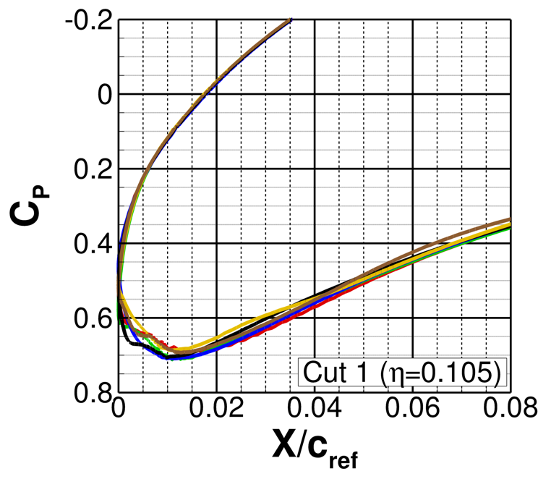
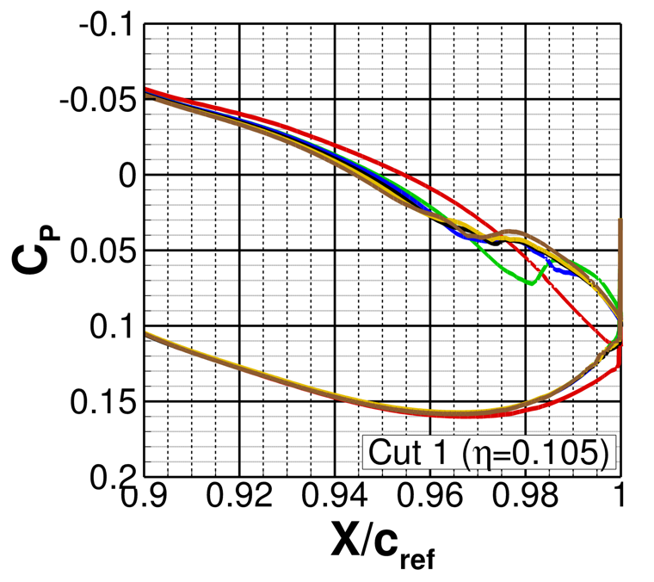
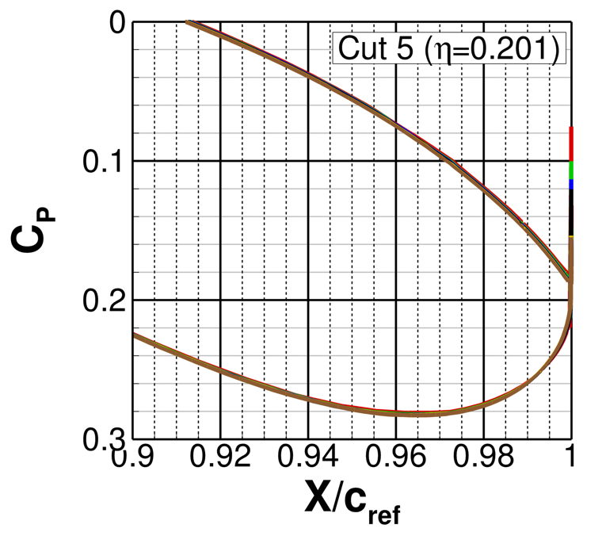
Case 1a: Inboard Pressure Cuts
Only minimal differences seen in inboard-most C_{P} cuts
Largest differences seen at inboard cut trailing edge
Region of interest for SOB separation region
Grid density has a large effect on the junction flow
Moderate deviations near the leading edge lower surface
Decreased differences outside of junction flow region (Cut 5 plotted)

Slide 12
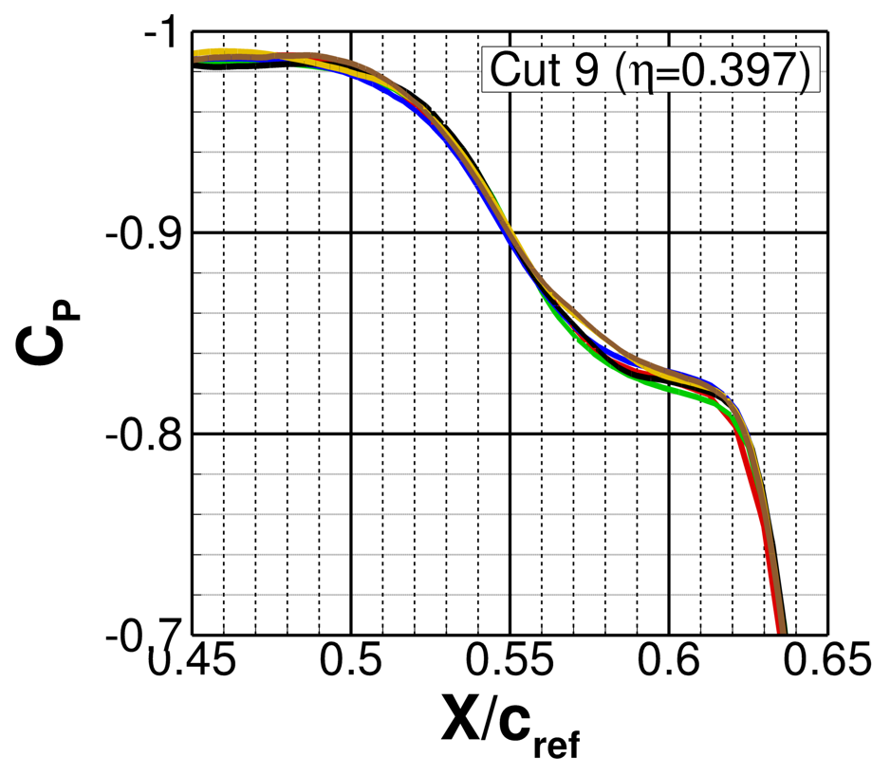
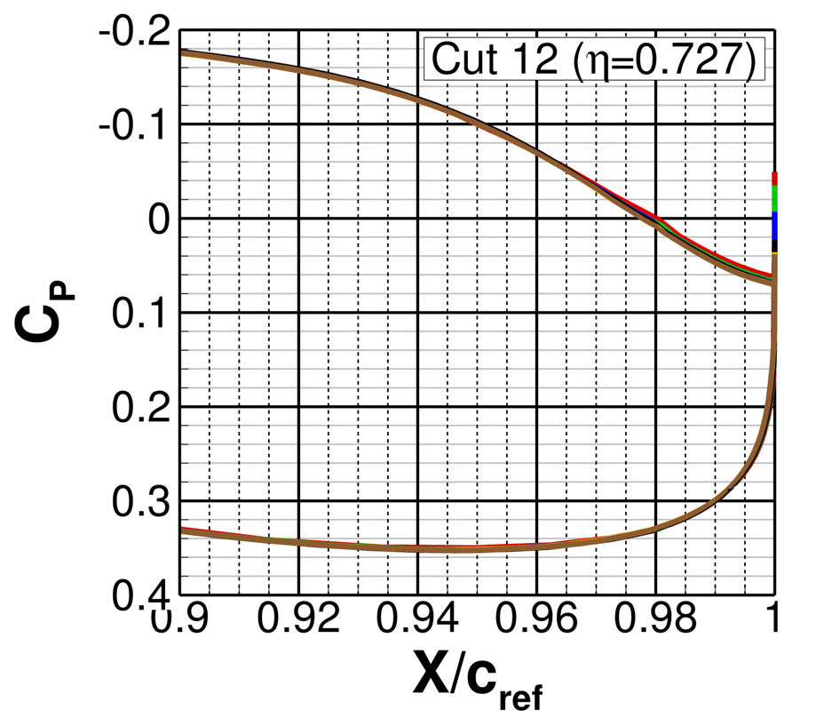

Case 1a: Midspan and Outboard Pressure Cuts
Few differences seen in shock strength or location for the midspan and outboard locations (Cuts 9 and 12 representative of all results)
Minimal variations seen in trailing edge behavior (Cut 12 is representative)

Slide 13
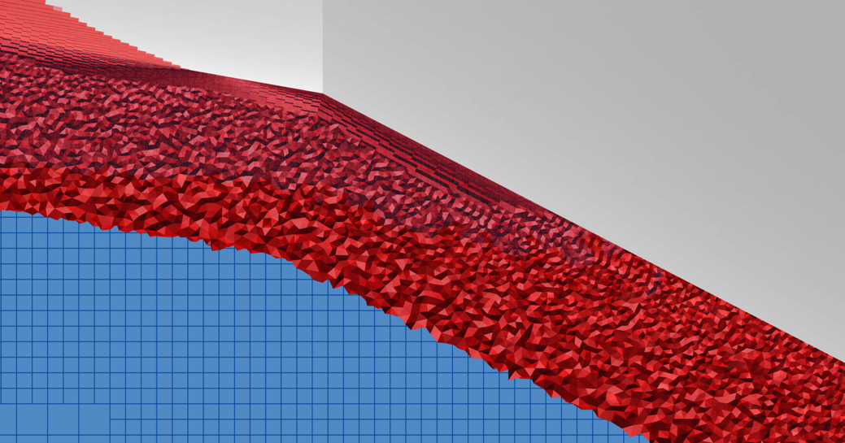
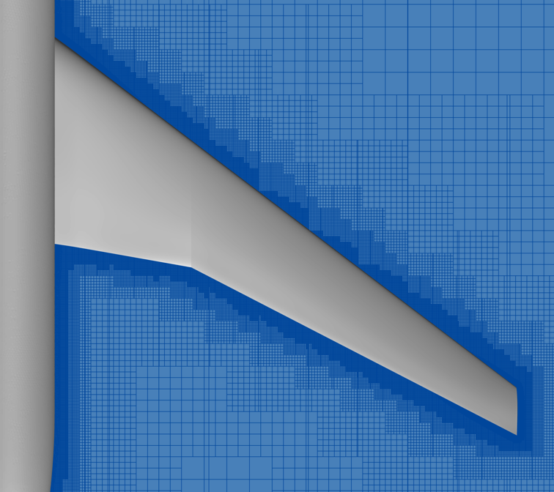

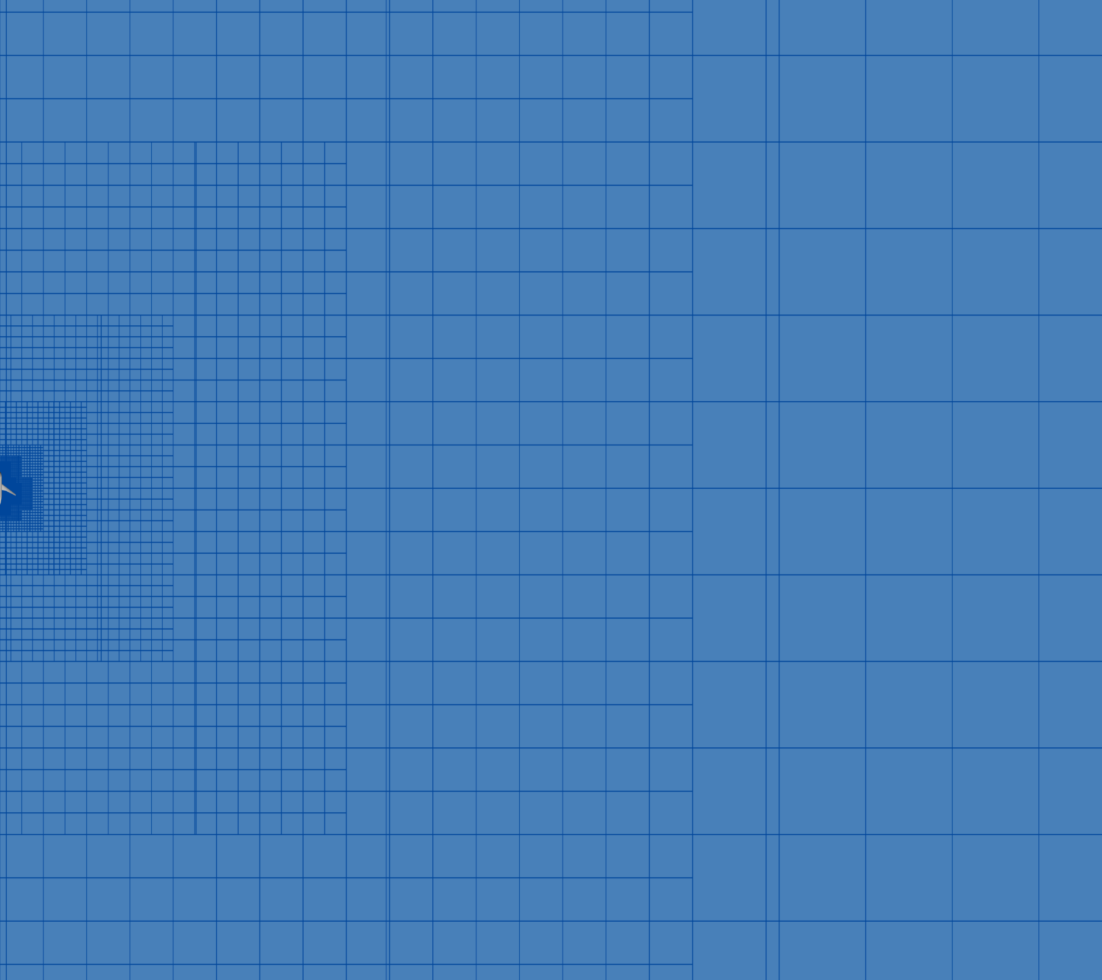
Case 1a: Overset Computational Domain
Inner-most Cartesian cell size of outer unstructured cell (best practice)
Outer box extends ~110 c_{ref} in all directions
Cartesian growth rate automatically determined

Slide 14
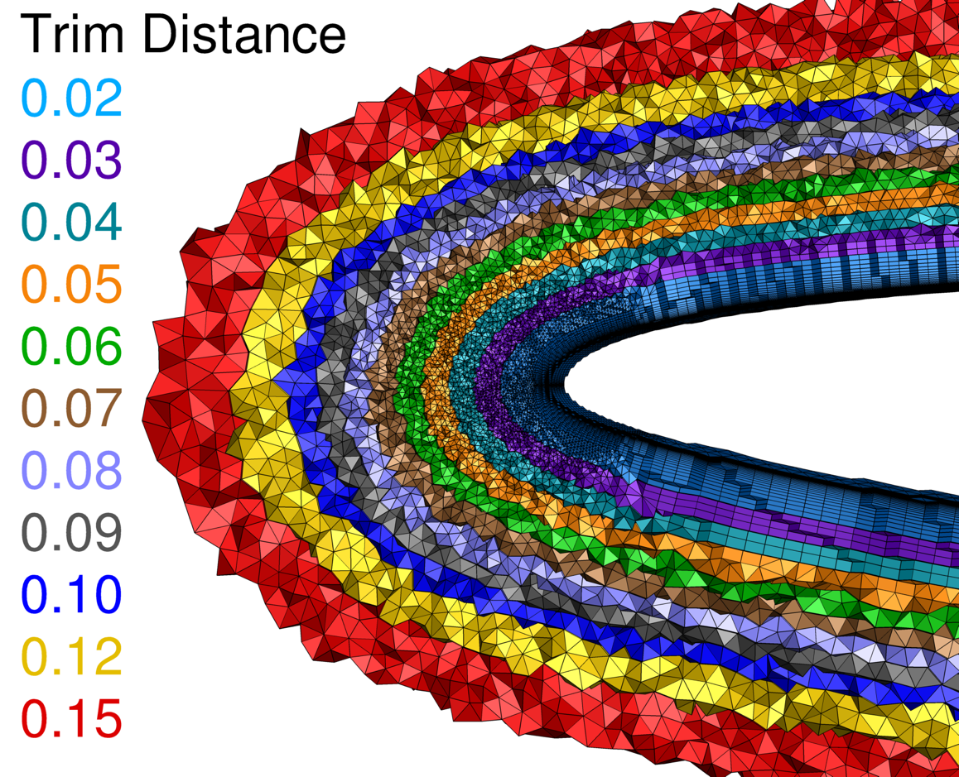
Case 1a: Trim Distance Study
Nearbody grids trimmed using carp
Kestrel’s grid manipulation package
Supports numerous grid formats (including ugrid)
Inner grid trimmed at a range of distances
Simulations were executed at constant 𝛼 (2.758 deg.) with minimal difference in drag or convergence
Selected trim
distance (0.06)

Slide 15
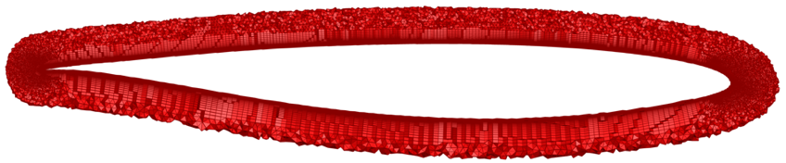
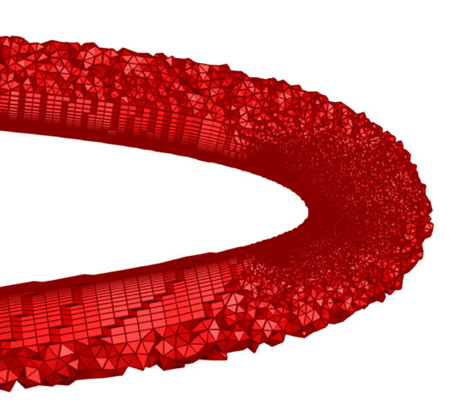
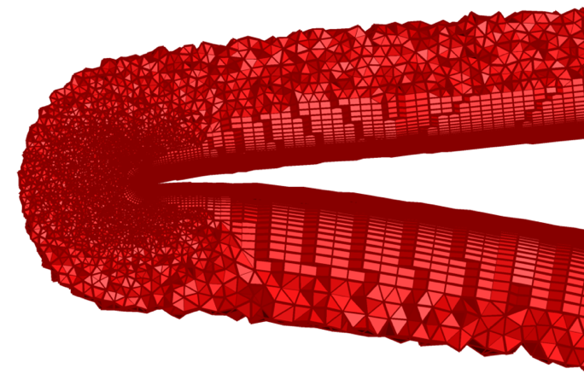
Case 1a: Trimmed Grid Visualization
Selected 0.06
Close trim distance can lead to erroneous results and solution instability
Largely isotropic cell spacing at selected distance
Trim distance held constant for subsequent solutions

Slide 16
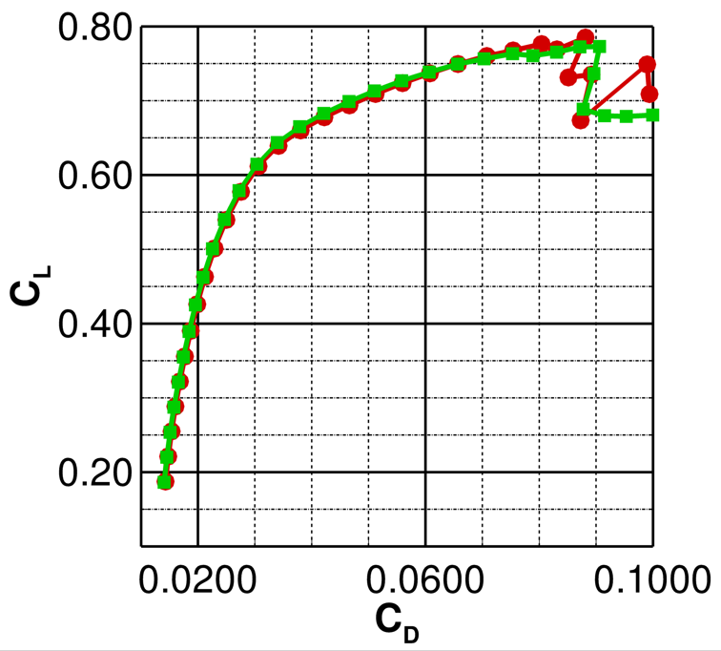
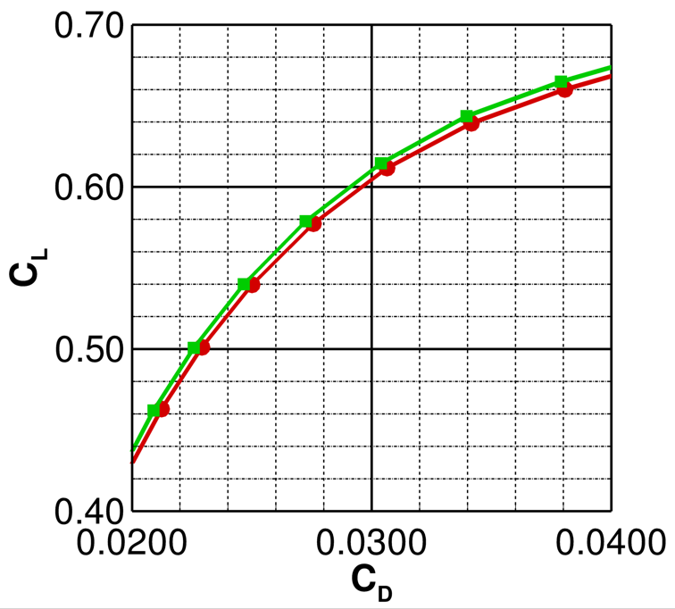
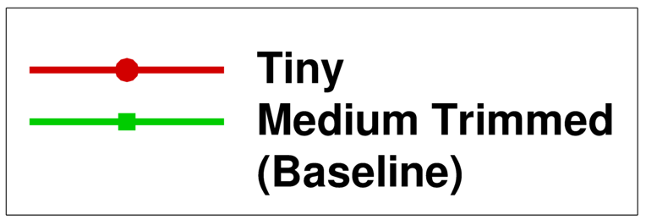
Case 1a: Aerodynamic Performance
Alpha sweep executed on tiny and medium/trimmed (baseline) grids
Sweep from 𝛼 of 0 to 8 deg. shown every 0.25 deg. (total of 86 jobs)
Tiny grid yields decreased 𝛼_{pitchup} and deeper C_{M} bucket (not shown)
Difference in inboard flow separation ~0.50 deg.
Deviations observed in deep stall region

Slide 17
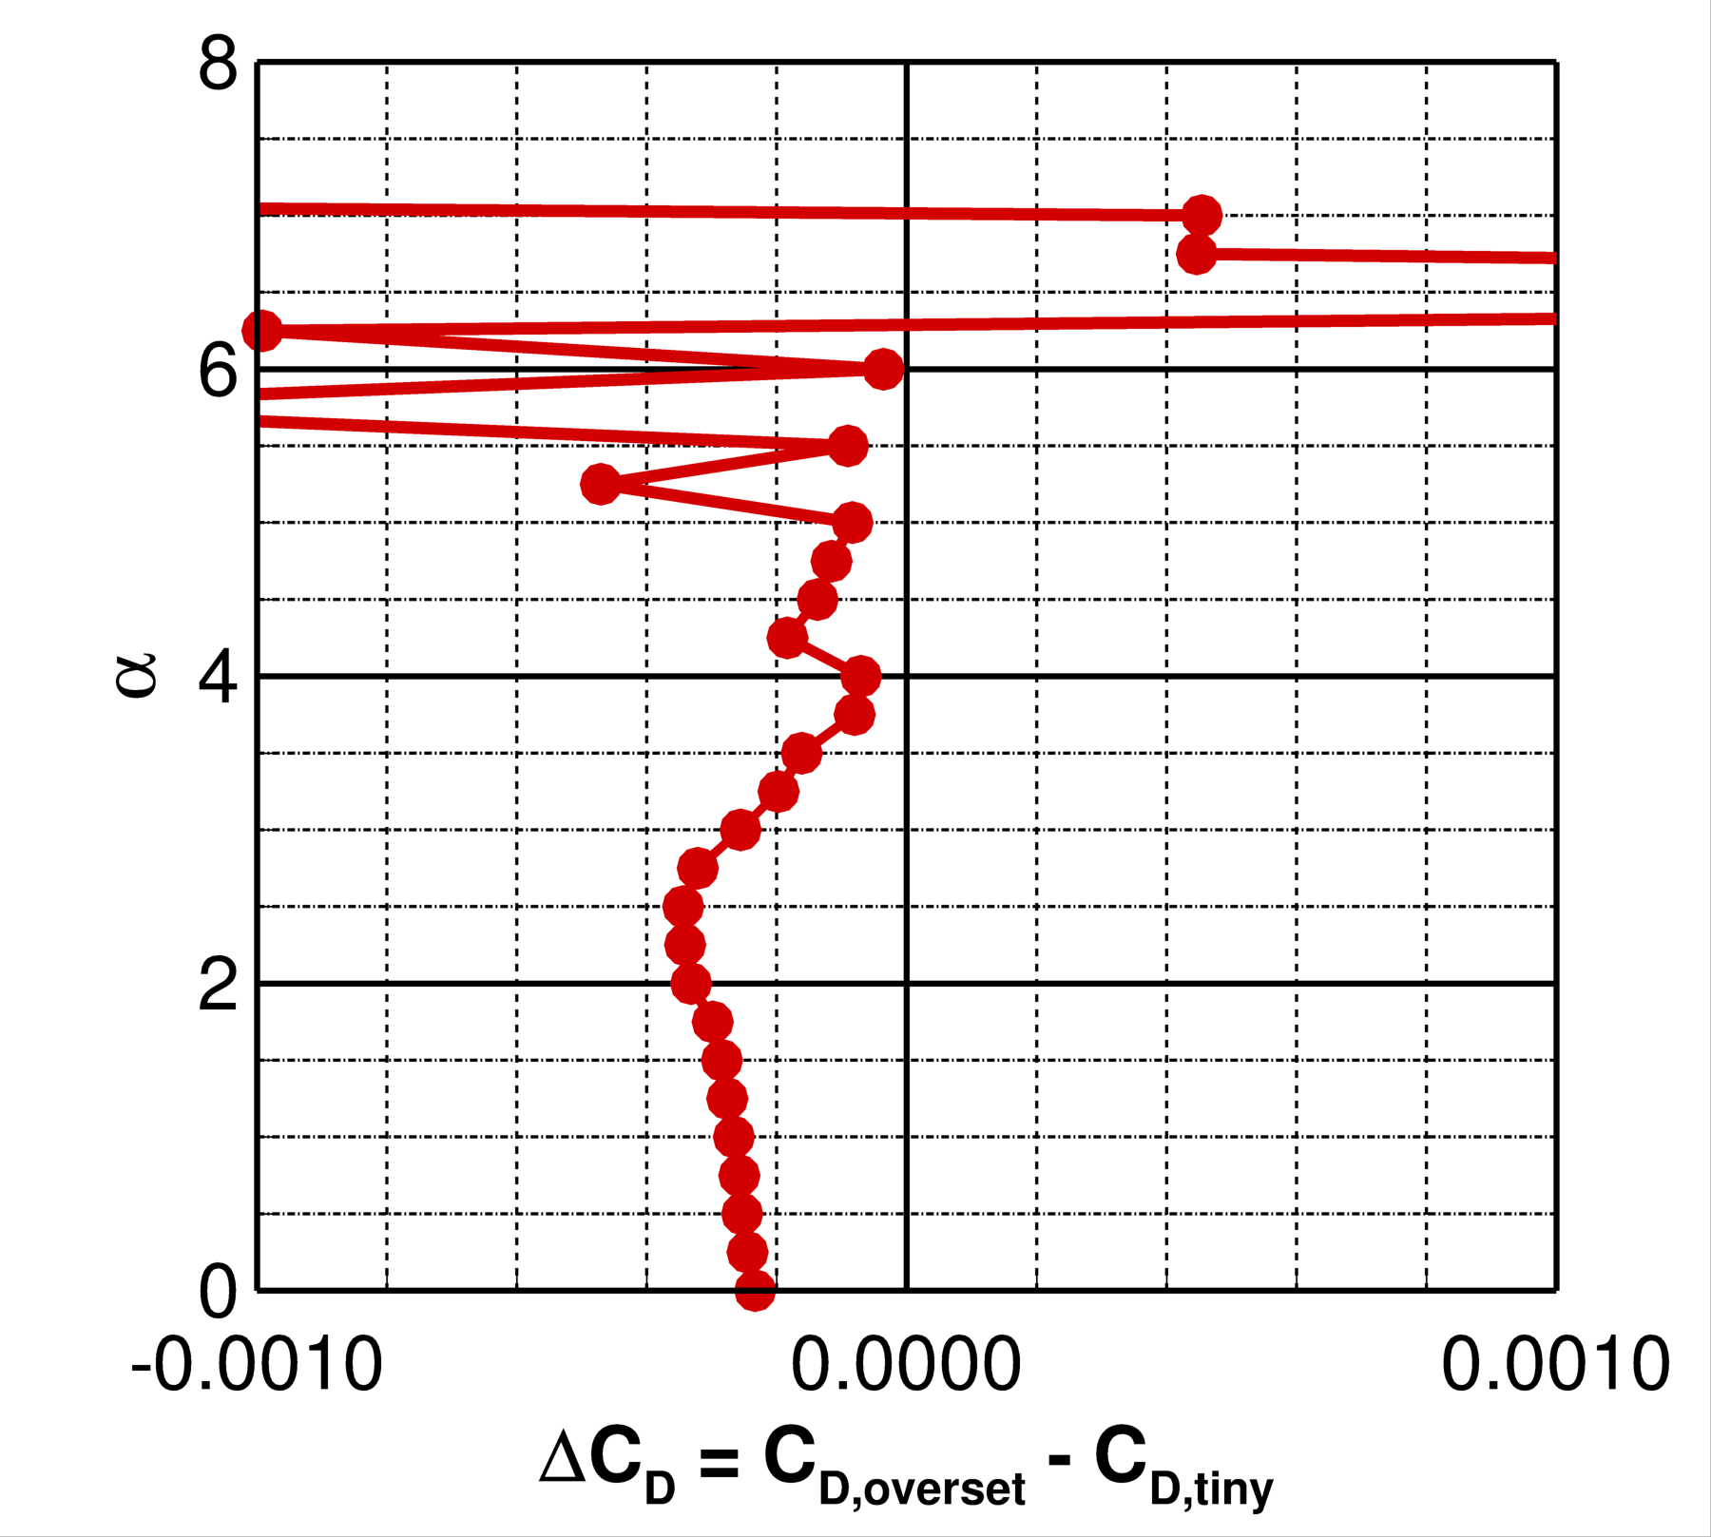
Case 1a: Aerodynamic Performance
Alpha sweep executed on tiny and medium/trimmed (baseline) grids
Sweep from 𝛼 of 0 to 8 deg. shown every 0.25 deg. (total of 86 jobs)
Tiny grid yields decreased 𝛼_{pitchup} and deeper C_{M} bucket (not shown)
Difference in inboard flow separation ~0.50 deg.
Deviations observed in deep stall region
C_{D} differences ~2.2 counts at 𝛼 of 3.00 deg.
(deg.)

Slide 18
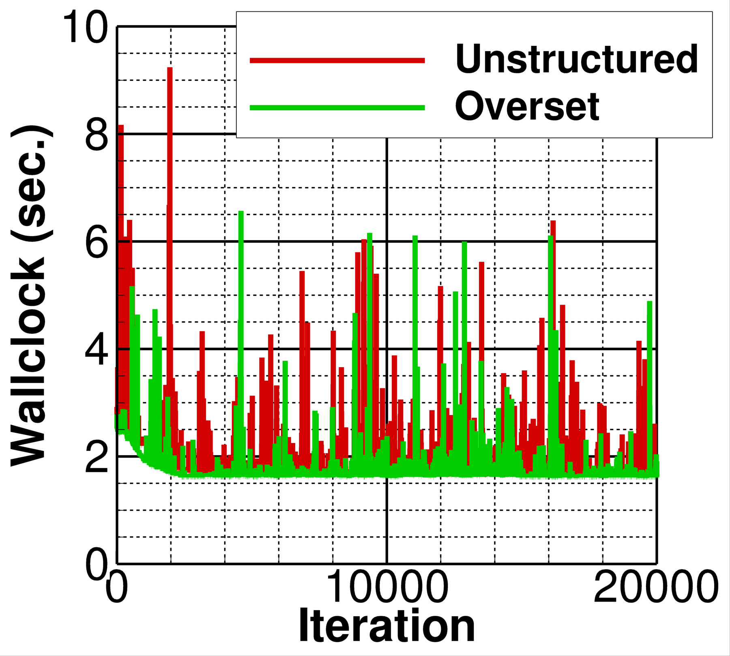
Case 1a: Computational Cost
Total cost for medium-density mesh
Fully unstructured grid
Trimmed grid at 0.06
1600 CPUs (40 Skylake nodes)
About 10.5 hours total for overset formulation
Cost per iteration is primarily between 2 and 4 sec. (without refinement)
Overset solution yields ~50% reduction in computational cost relative to unstructured

Slide 19
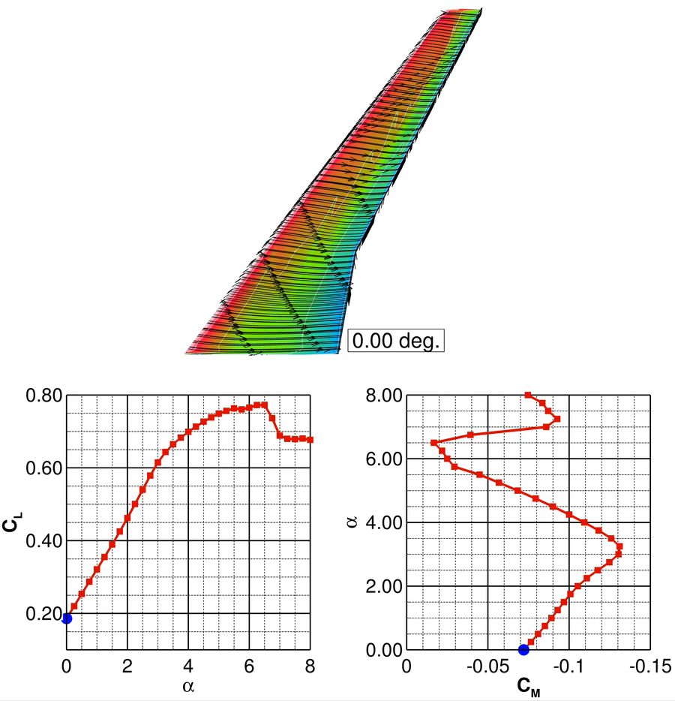
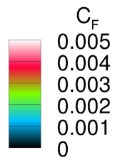
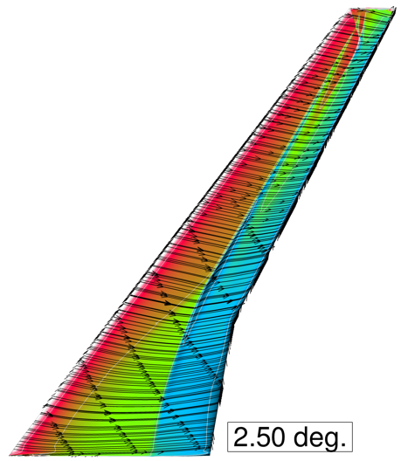
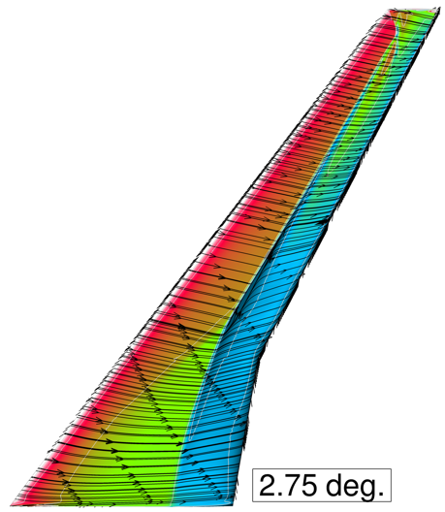
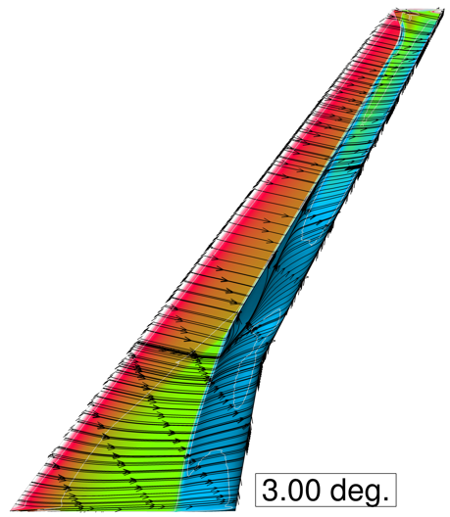
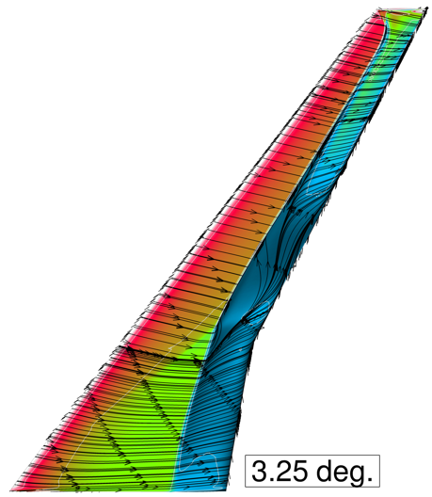
Case 1a: Medium Trimmed Grid Alpha Sweep
C_{F}
Pitch break at ~3.0 deg. (C_{L} ~0.62)
Inboard wing separation at ~7.25 deg.
2.50 deg.
2.75 deg.
(deg.)
Trailing Edge
Separation
3.00 deg.
3.25 deg.
(deg.)

Slide 20
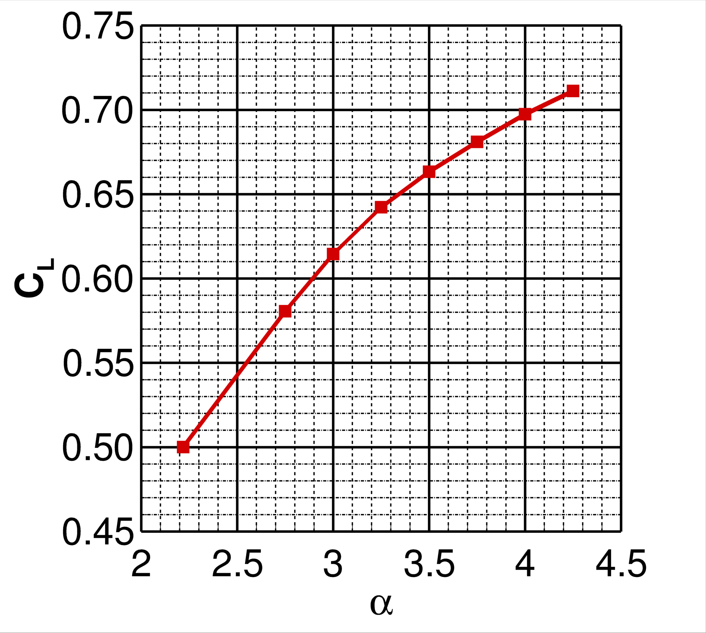
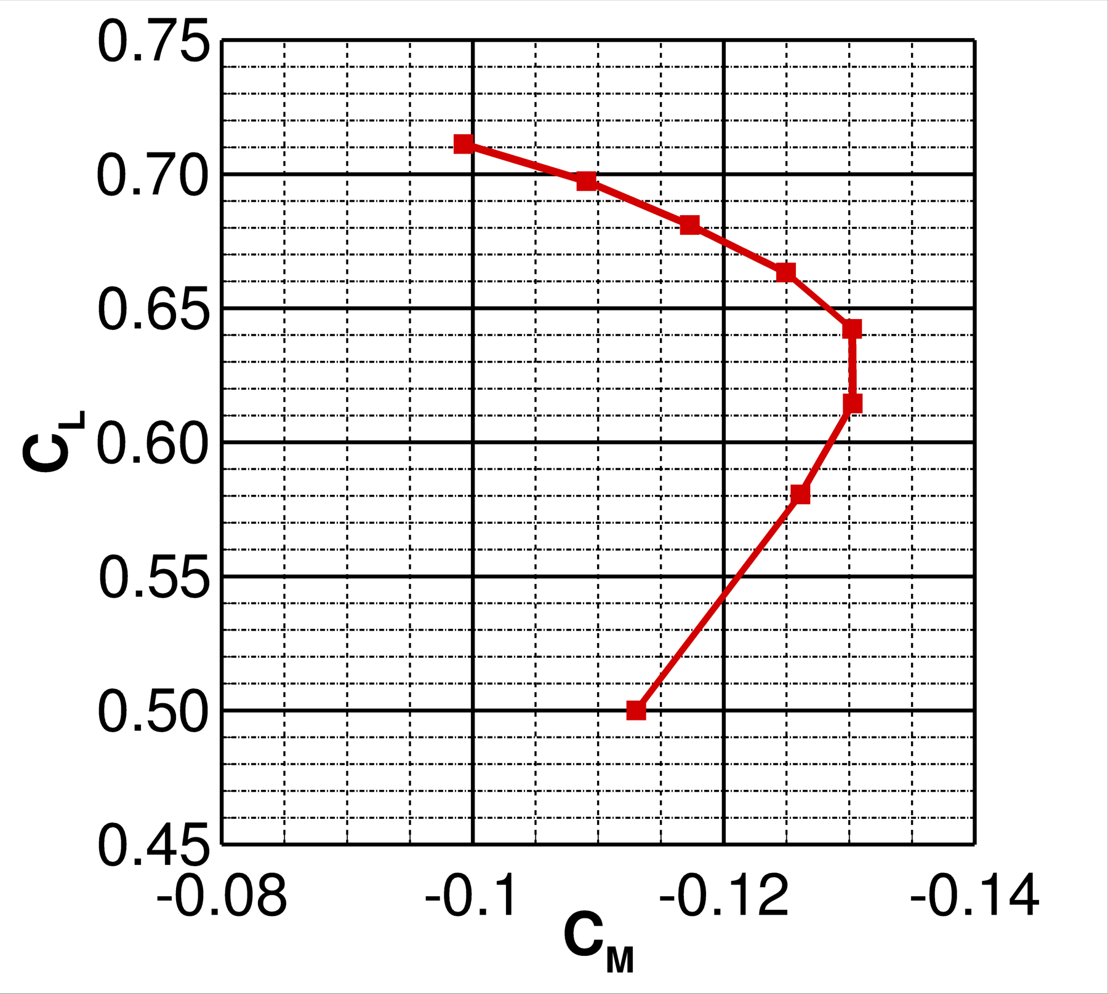
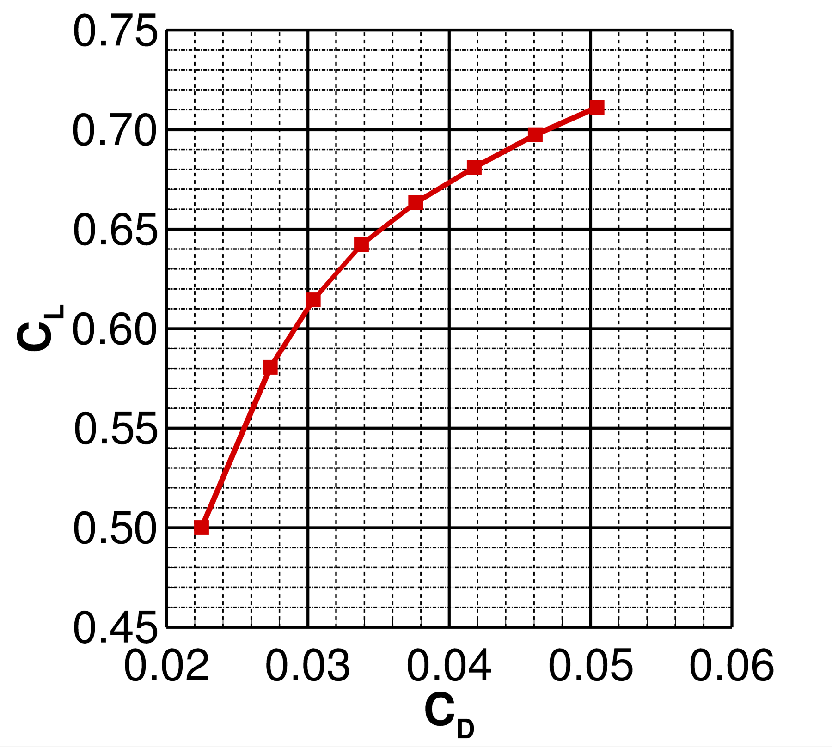
Case 2a: Polar
Executed with medium grid and appropriate aeroelastic deformations
Increasing flow separation observed for 𝛼 > ~3.0 deg.
Progressive decambering leads to monotonically-decreasing C_{L𝛼} slope
Pitching moment break observed near C_{L} ~0.62
(deg.)

Slide 21
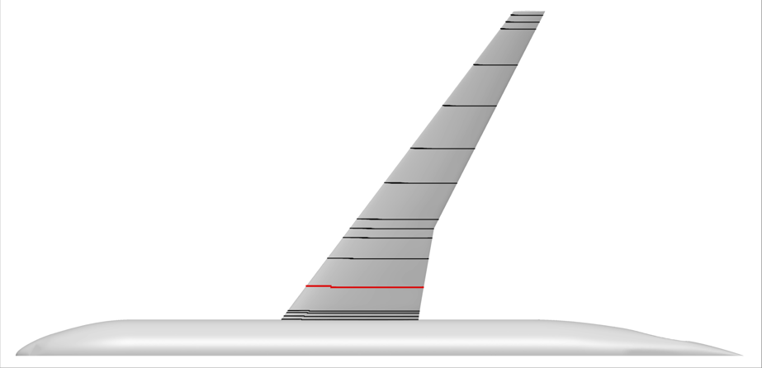
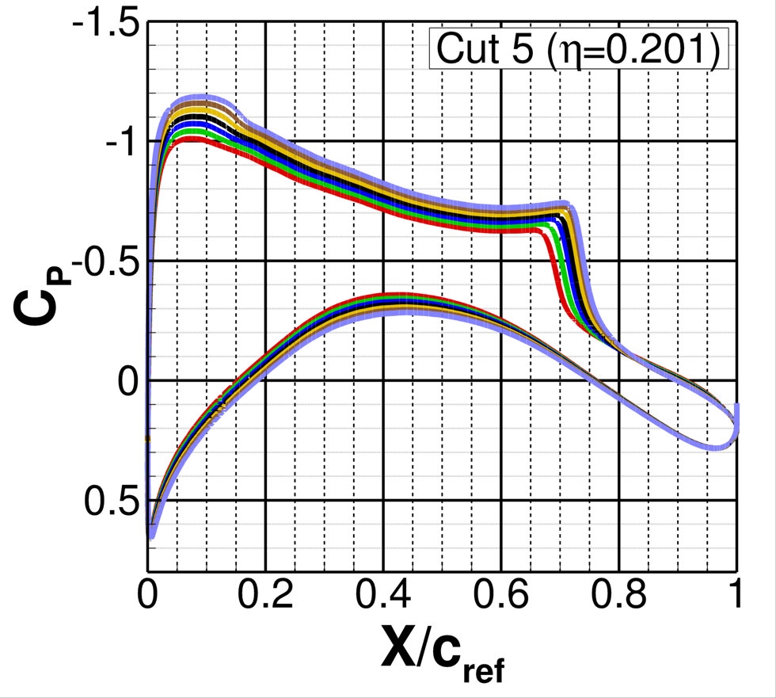
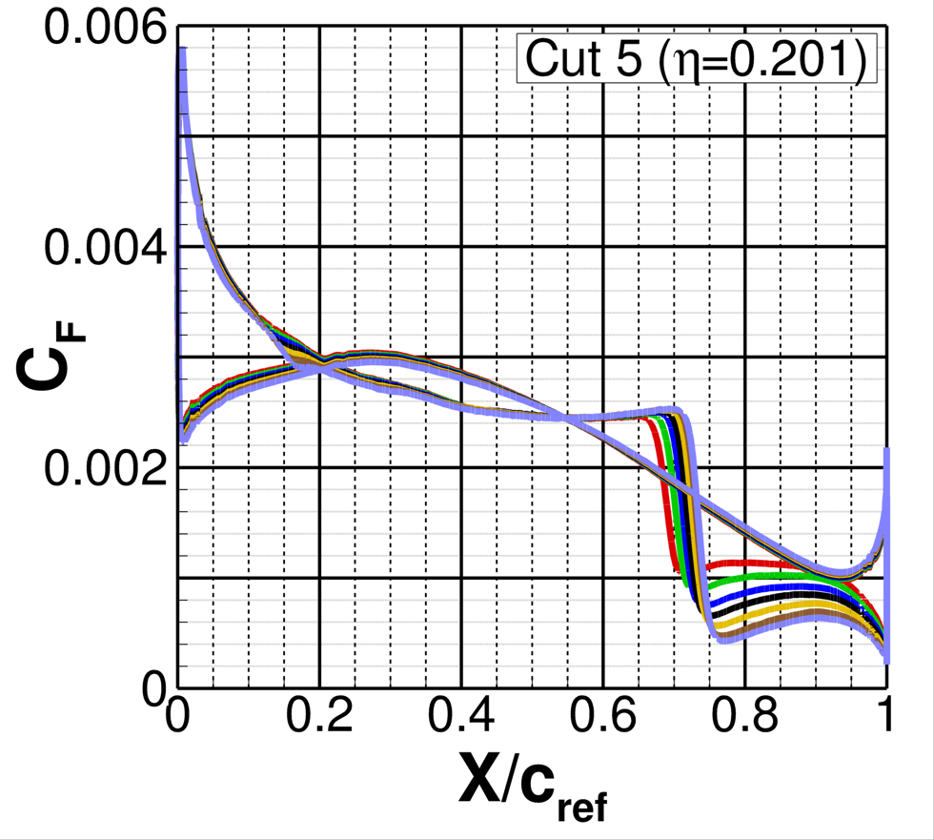
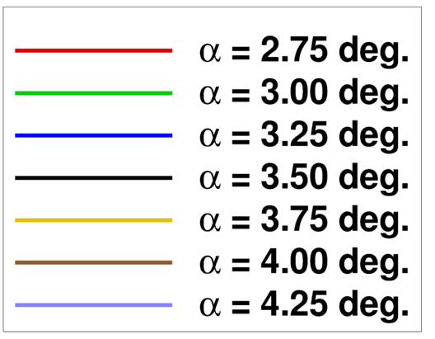
Case 2a: Inboard Surface Cuts
Increasing angle of attack yields a downstream shift in shock location
Shock clearly evidenced by C_{P} and C_{F}
Flow nominally attached downstream of the shock
Decelerated flow seen at trailing edge

Slide 22
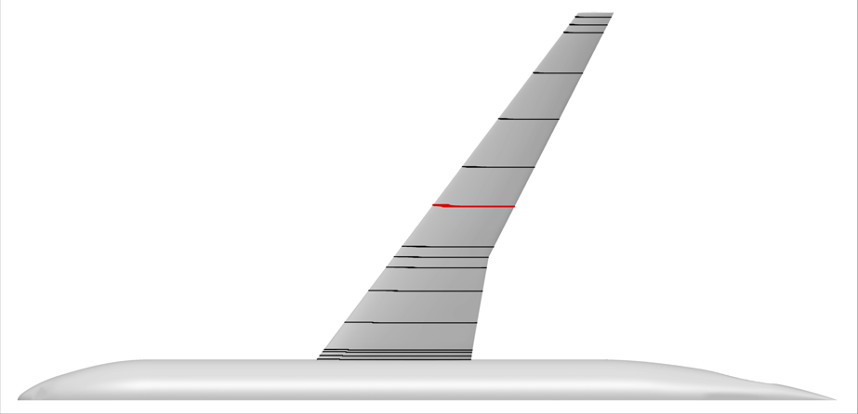
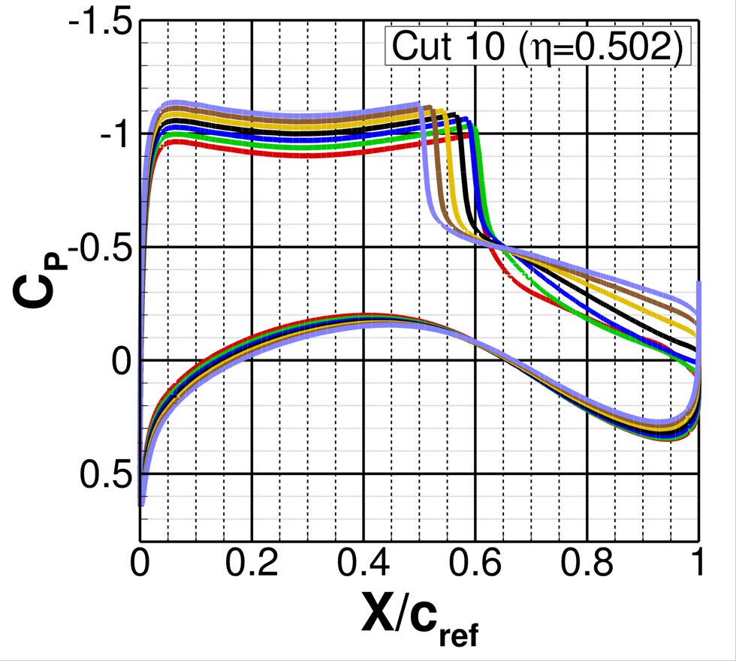
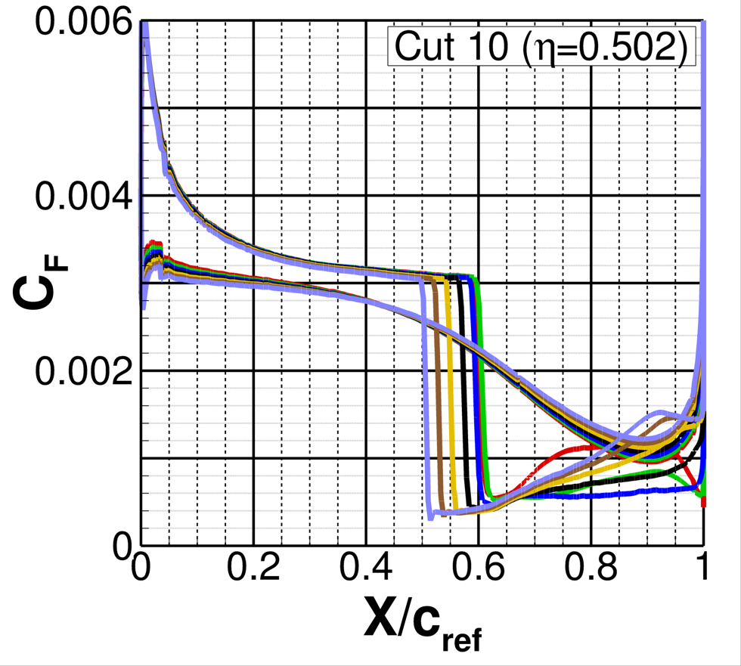
Case 2a: Mid-Span Surface Cuts
Downstream shift in shock observed with larger angles of attack (expected)
No double shocking at high angles
Flow separates at shock location and fails to reattach above 𝛼 = 3.25 deg.

Slide 23
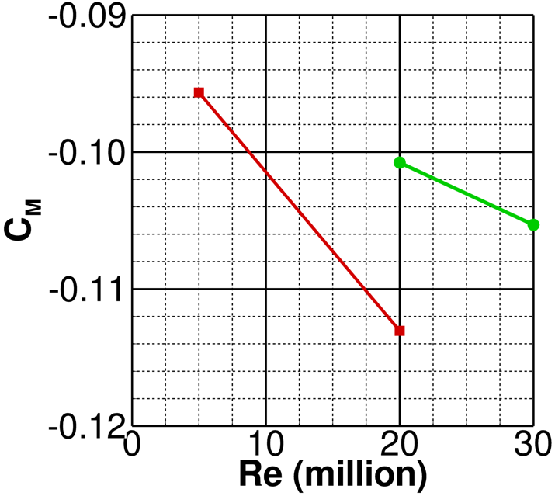
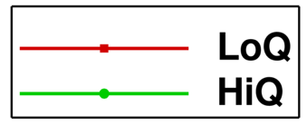
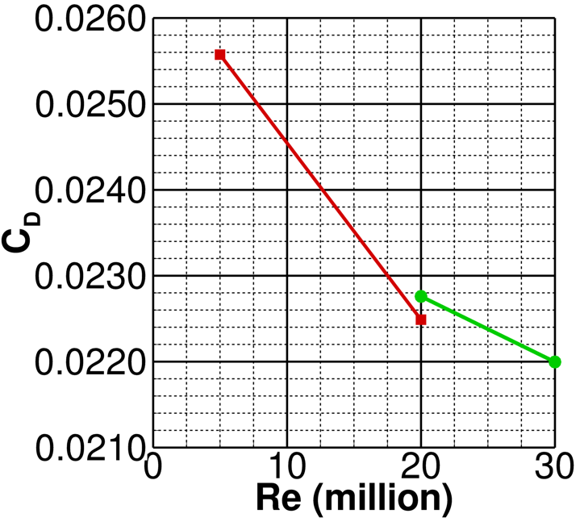
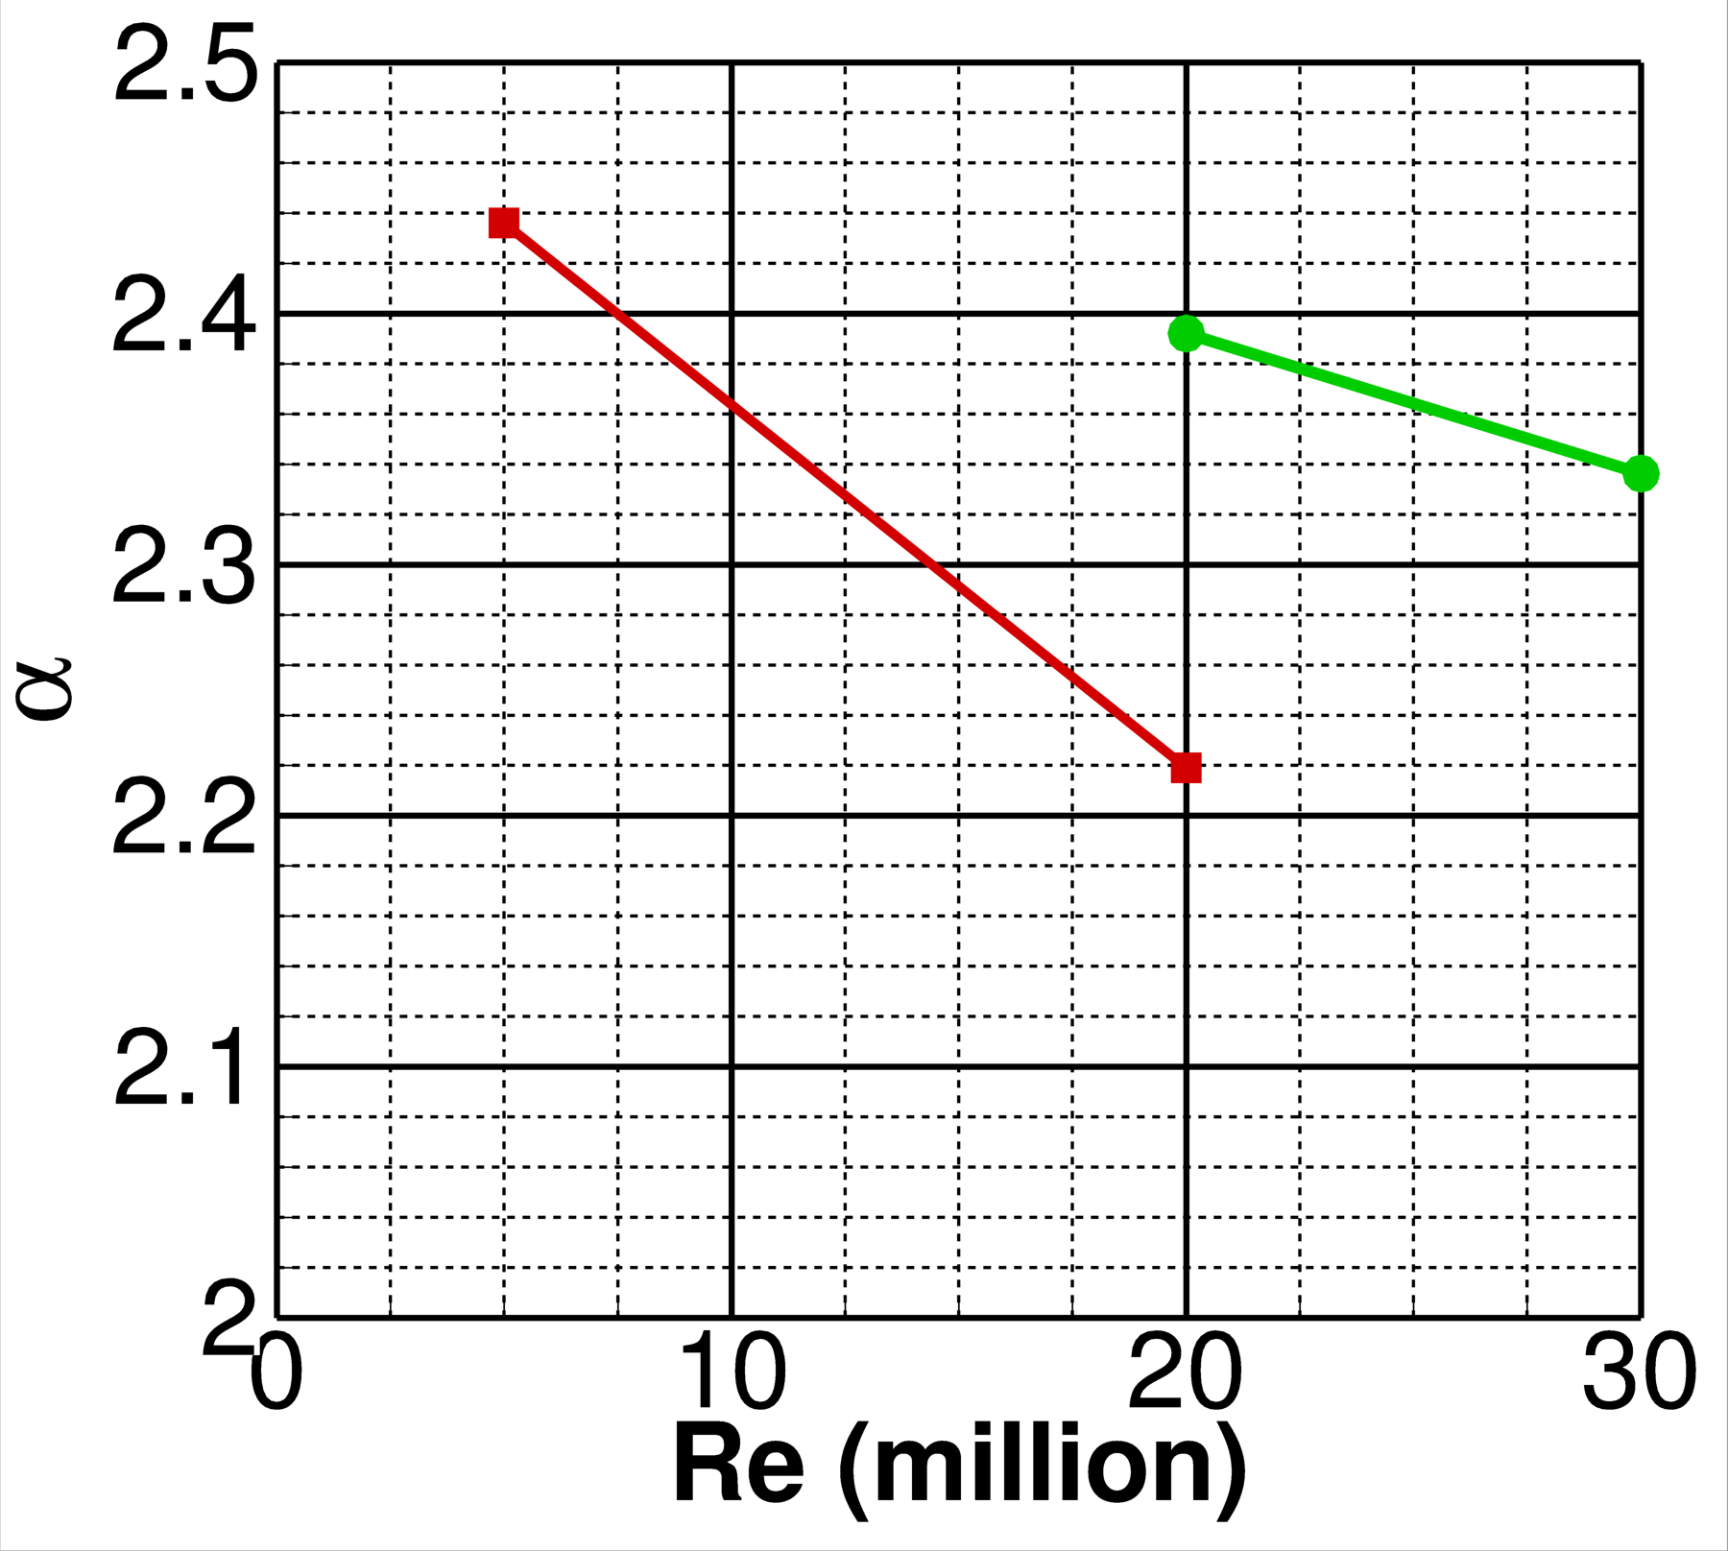
Case 3: Reynolds Number Sweep
Executed on LoQ and HiQ lofts at C_{L} = 0.50
Significant drag rise with decreased Re (expected)
Large drag rise seen from Re of 20 million to 5 million (expected)
(deg.)

Slide 24
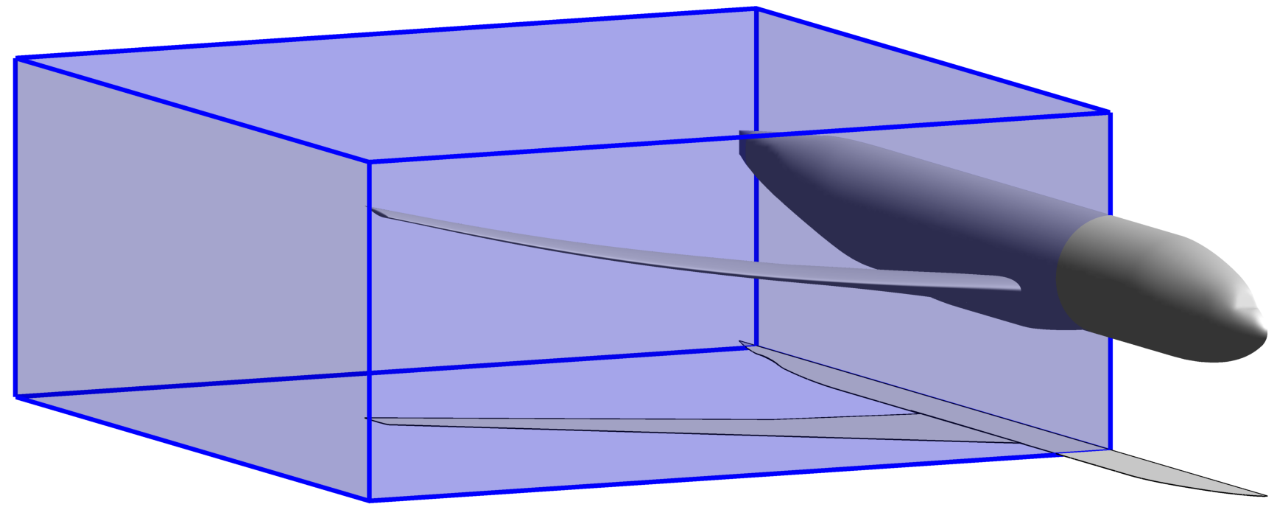
Case 4: RANS Adaptive Mesh
Adaptive mesh refinement performed in offbody Cartesian grid
Nearbody-grid adaptation not yet available
User-specified region limits shown in blue box
Amount of refinement based upon a threshold value
Separated wake led to decision to refine based on ω
Refinement applied every 250 iterations
Adaptation used over the entire simulation (not frozen)
Grid density must be traded with computational cost

Slide 25
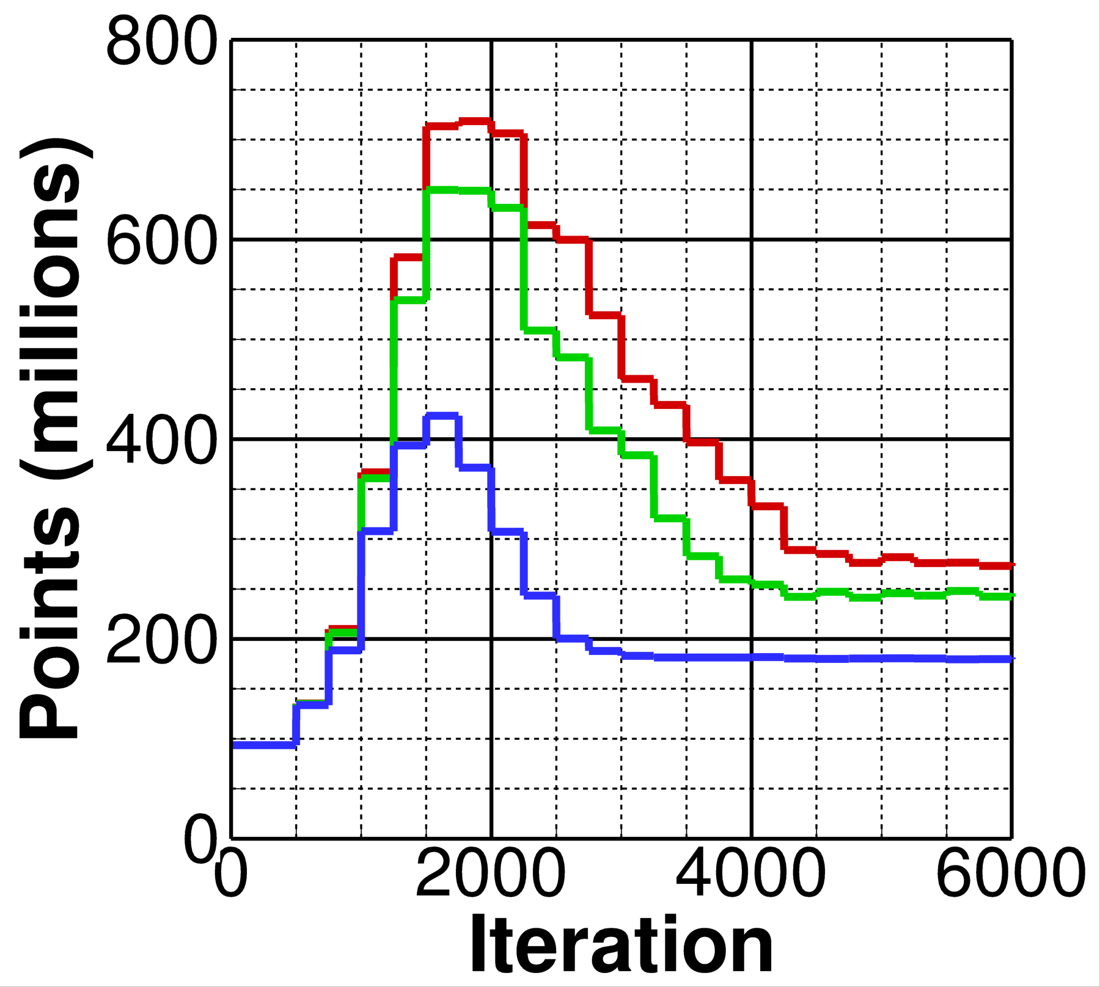
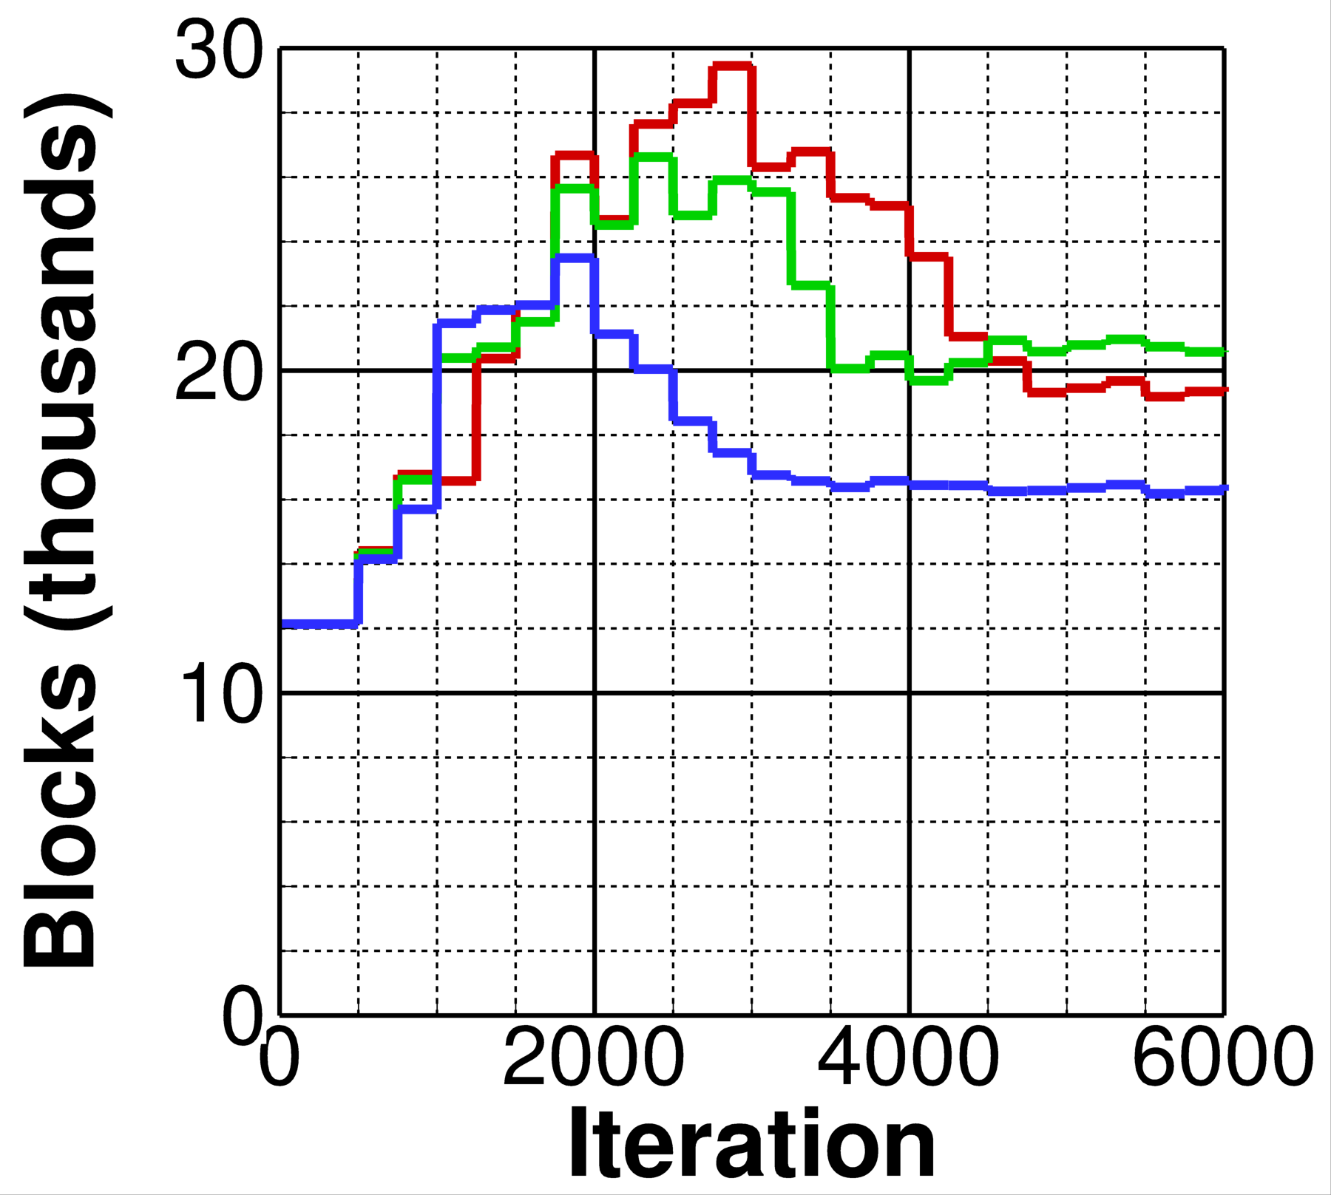

Case 4: Effect of Refinement Threshold (1/3)
Threshold value controls degree of grid refinement based on values of ω
Decreased threshold yields increased grid density
Cases run at threshold values from 40 through 200 (12 jobs total)
Executed for 6,000 iterations – sufficient to understand grid resolution
Cartesian grid convergence observed after 5,000 iterations
Analysis performed at 𝛼 = 2.75 deg. (plotted) and 4.25 deg.
Increasing
Density
2.75 deg.
2.75 deg.

Slide 26





Case 4: Effect of Refinement Threshold (2/3)
Selection of threshold significantly affects wake refinement
Chose threshold value of 60 with ~280 million cells in Cartesian region
Minimal grid changes at 𝛼 = 2.75 deg.
Adequately captures wing tip vortex, mid-span separation, and fuselage vortex
2.75 deg. thresh=60
2.75 deg. thresh=200
4.25 deg. thresh=60

Slide 27

Case 4: Effect of Refinement Threshold (3/3)
Range of thresholds analyzed at C_{L} of 0.58
Threshold value has minimal effect on F&M at this condition
Consistent with expected results
Improved resolution of the wake and the shock
This observation does not mean that refinement has no effect on the global F&M (covered in next slides)

Slide 28


Case 4: Aerodynamic Performance
Adapted grid yields only a slight reduction in lift and moment magnitude
Pitch-up break point extremely similar for both formulations
Observations consistent with typical Kestrel behavior
(deg.)
(deg.)

Slide 29



Case 4: Convergence History
Similar convergence history across full range
Differences in averaged values
Grid-adapted solutions yield decreased drag
C_{L} ~0.001
Maximum C_{D} delta ~3 counts
𝛼

Slide 30


Case 4: Pressure Cuts (C_{L} 0.58)
Overall, minimal changes observed in surface C_{P} data
Slight forward movement of shock at outboard locations

Slide 31

Case 5: Beyond RANS (DDES Adaptive Mesh)
Similar setup to RANS cases
Same refinement region and settings
SARC-QCR turbulence model
Averaging window
Simulation run for 26,000 iterations (not 20,000)
Began averaging at 20,000 iterations
Averaged for 6,000 iterations (not 2,000)
Nondimensional time step set to 0.010, dimensional time step falls out

Slide 32
Case 5: Beyond RANS (DDES Adaptive Mesh)

Slide 33
Case 5: Opportunities for Investigation
A more thorough investigation is warranted
Grid considerations
Appropriateness of current grids for DDES need to be investigated
Possibility of modeled stress depletion should be analyzed
Computational settings
Temporal damping may need to be considered
Examine impact of RC and QCR
Smaller time steps might be significant

Slide 34
Summary
Analysis performed on Cases 1a, 2a, 3, 4, and 5
Excellent unstructured grid convergence achieved
Pitch break observed C_{L} ~0.62
Offbody adaptive mesh refinement improved wake prediction, but minimal effect on integrated F&M
Unsteady DDES yielded earlier separation than RANS

Slide 35

Questions?

